Slide 1
Design and Simulation of Bidirectional dc-dc converter
Submitted by:
Abhilash shanker
12404en016
Supervisor:
Dr. kalpana Chaudhary
Associate professor
Department of electrical engg.
Iit bhu, varanasi

Slide 2
Overview
Bidirectional dc – dc converter and its uses
Operation of bidirectional dc – dc converter
Design of basic bidirectional dc – dc converter
Simulation
Hardware
Observations and results
Future scope

Slide 3
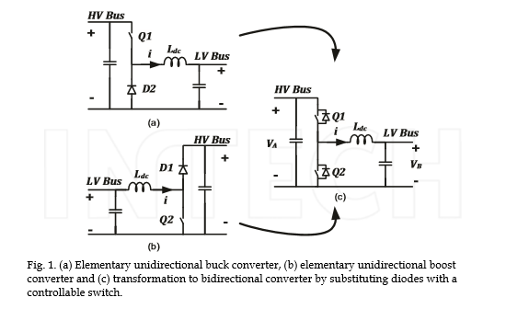
Bidirectional dc – dc converter

Slide 4
Characteristics
Bidirectional dc-dc converters have recently received a lot of attention due to the increasing need to systems with the capability of bidirectional energy transfer between two dc buses.
Buck operation from one side
Boost operation from other side

Slide 5
Uses of bidirectional dc – dc converter
In energy storage in renewable energy systems to remove fluctuation in supply to load
Fuel cell energy systems
In hybrid electric vehicles (HEV) to link different buses (For example, a BDC is used to exchange energy between main batteries (200-300V) and the drive motor with 500V dc link.)
Uninterruptible power supplies (UPS)

Slide 6
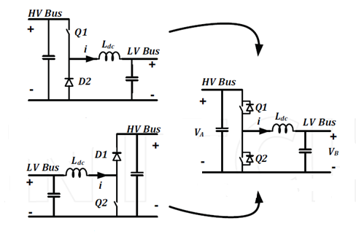
Operation of bidirectional dc – dc converter
In boost mode,
the switch Q2 acts
as a boost switch
and the switch Q1
acts as a boost diode
In buck mode,
Q1 acts as a buck switch and Q2 acts as a buck diode.
This configuration of the switches and diodes cause the bidirectional flow of the power.

Slide 7
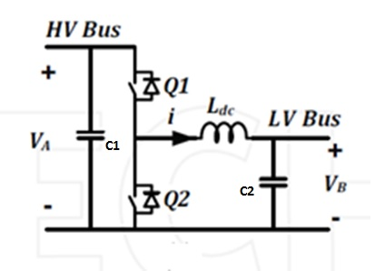
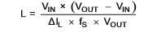
Design of bidirectional dc – dc converter
Inductor design( Ldc)
L = inductance
V_{IN} = input voltage
V_{OUT} = desired output voltage
f_{S} = minimum switching frequency of the converter
ΔI_{L} = estimated inductor ripple current,
A good estimation for the inductor ripple current is 20% to 40% of the output current.

Slide 8

Buck output capacitor( C2)
C2 or C_{OUT(min)} = minimum output capacitance
ΔI_{L} = estimated inductor ripple current
f_{S} = minimum switching frequency of the converter
ΔV_{OUT} = desired output voltage ripple(assumed)

Slide 9
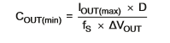
Boost output capacitor( C1)
C1 or C_{OUT(min)} = minimum output capacitance
I_{OUT(max)} = maximum output current of the application
D = duty cycle calculated
ΔV_{OUT} = desired output voltage ripple
fS = minimum switching frequency of the converter

Slide 10
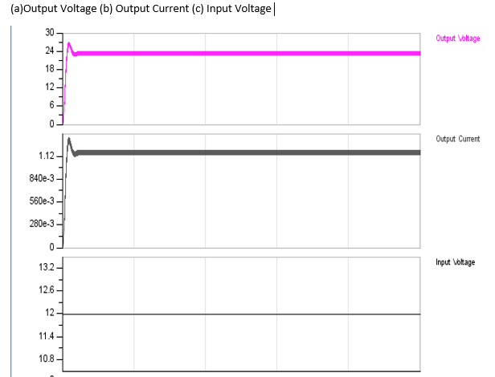
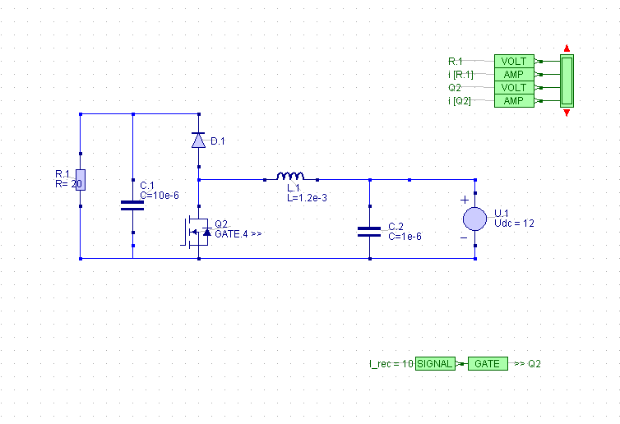
Simulation
Boost operation

Slide 11
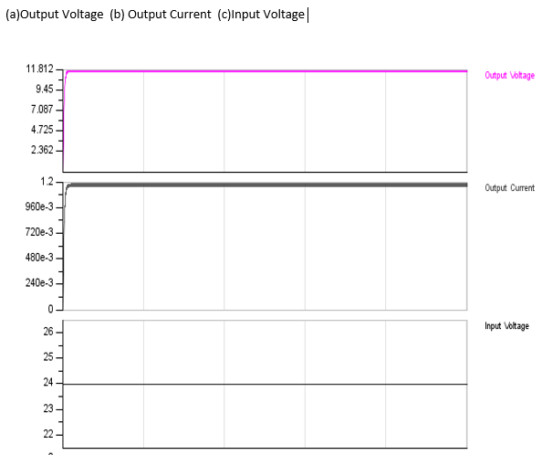
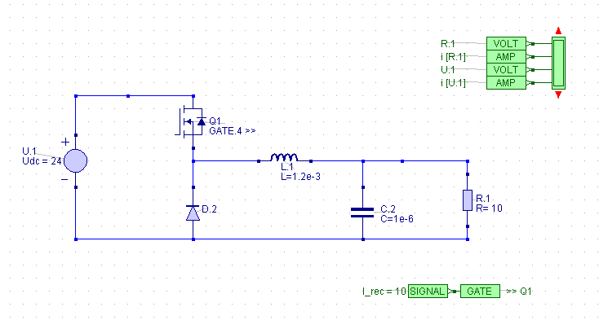
Buck operation

Slide 12
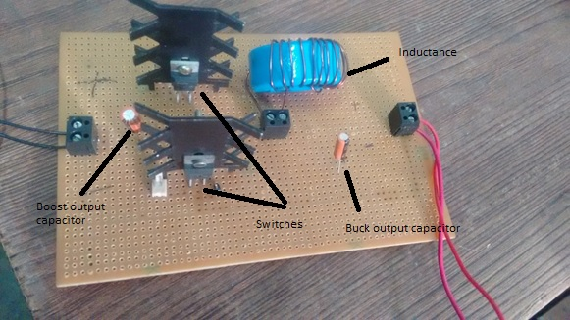
Hardware

Slide 13
Hardware components
Switches (Mosfet Irf530 : Vdss = 100 V , ID = 14 A)
Electrolytic capacitors (BUCK output capacitance = 2.2 µF
BOOST output capacitance = 100 µF)
Inductor with toroid core (900 µH)

Slide 14
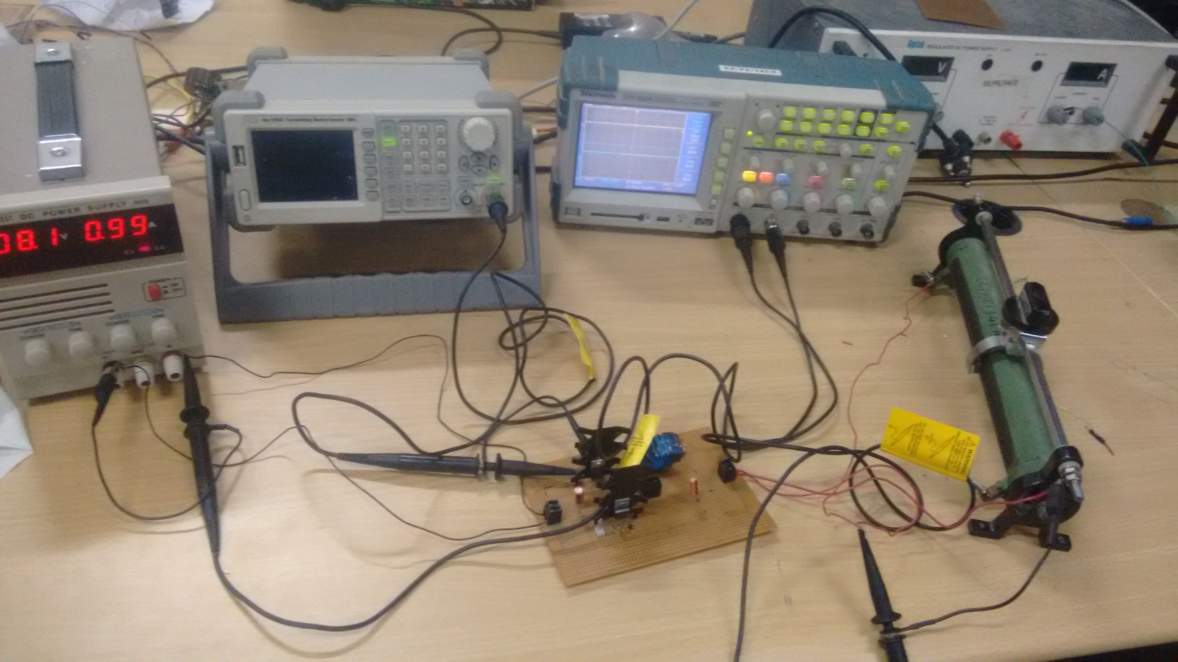
Hardware Setup

Slide 15
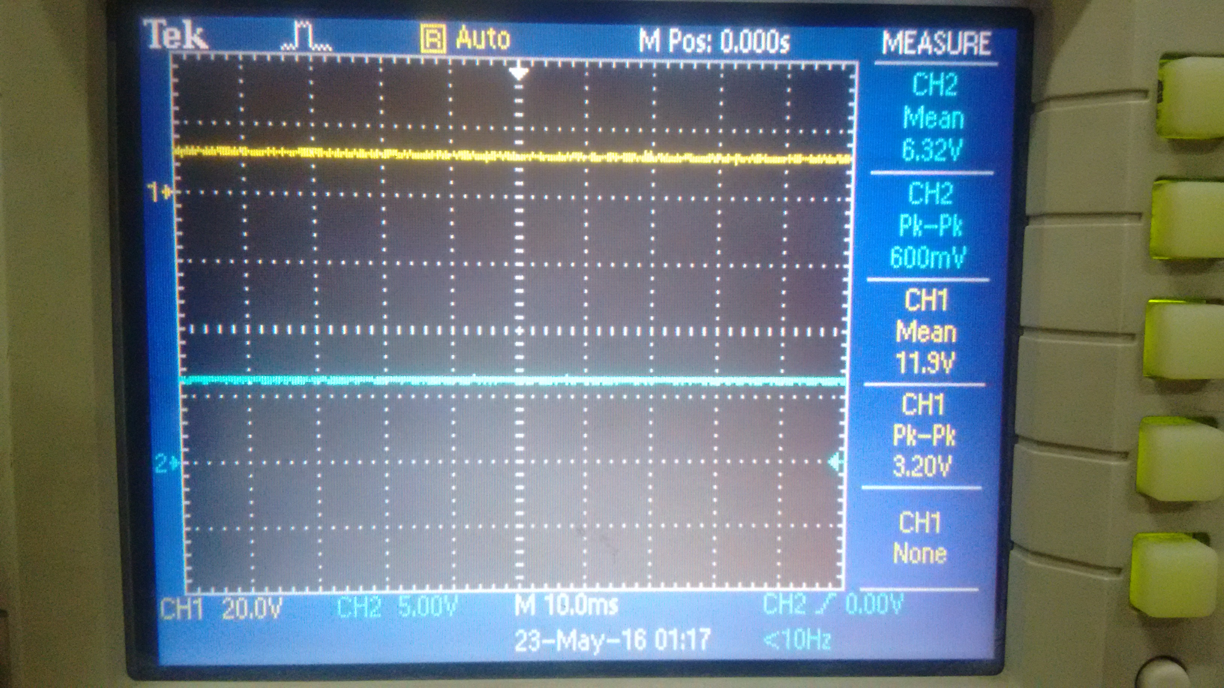
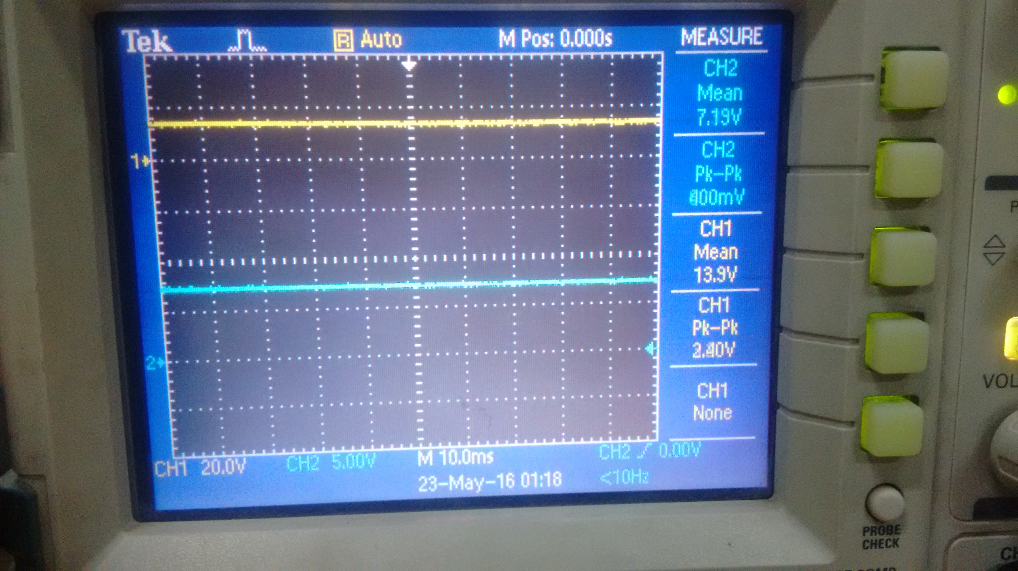
Hardware results
Boost operation
Duty ratio | Vin | Vout
0.5 | 6.32 | 11.9
0.5 | 7.19 | 13.9

Slide 16
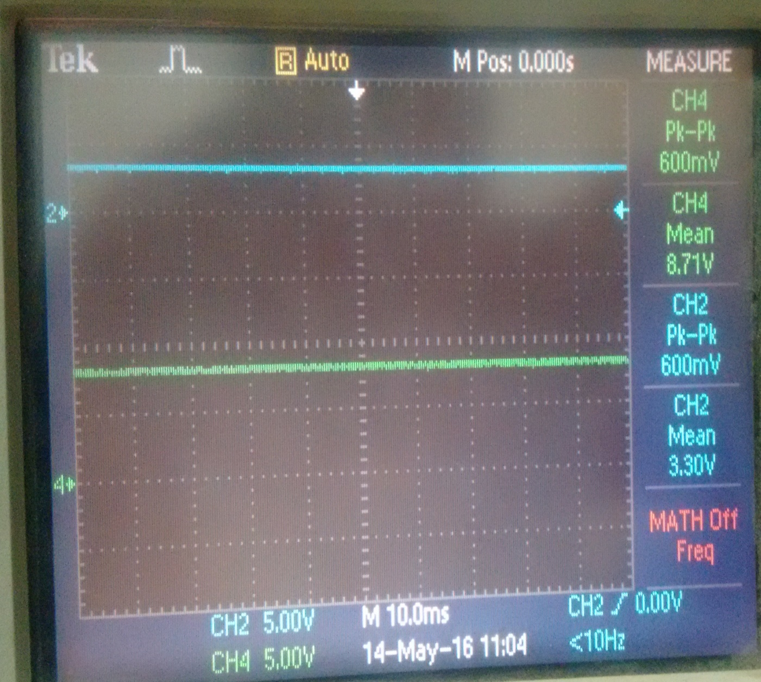
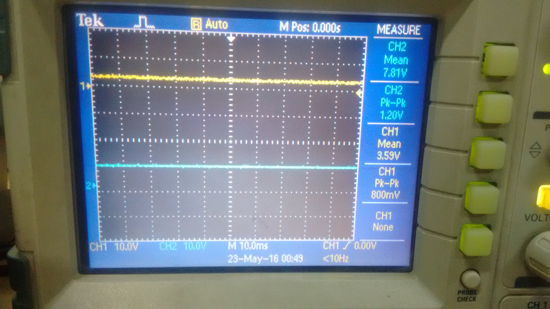
Buck operation
Duty ratio | Vin | Vout
0.5 | 8.71 | 3.30
0.5 | 7.81 | 3.59

Slide 17
Future scope
By using energy storage devices in the renewable energy system, fluctuations can be absorbed to deliver smooth power to consumers and at the same time maximize the energy output of renewable resources and will reduces the output required from conventional power stations which directly reduces CO2 emissions.
Energy storage systems have other technical applications in the utility grid including grid stabilization, frequency and voltage support, power quality and reliability enhancement and load shifting.

Slide 18
THE END

